Slide 1
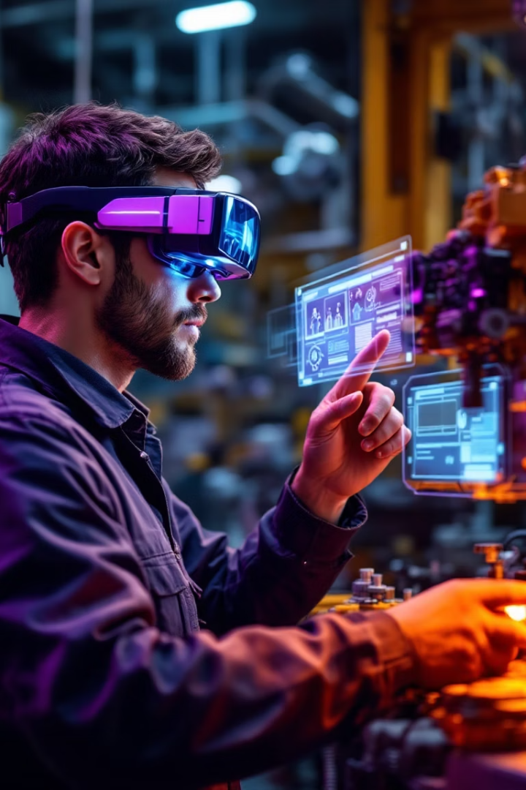

AR Maintenance Assistant: Preserving Tribal Knowledge
SME manufacturing plants lose 40% of repair expertise to retirement. Downtime costs autoparts factories $22,000 per hour.
Tribal knowledge gaps cause repairs to take 3.2x longer. Most maintenance issues (67%) repeat within 18 months.
by Lakpa Finju Sherpa

Slide 2
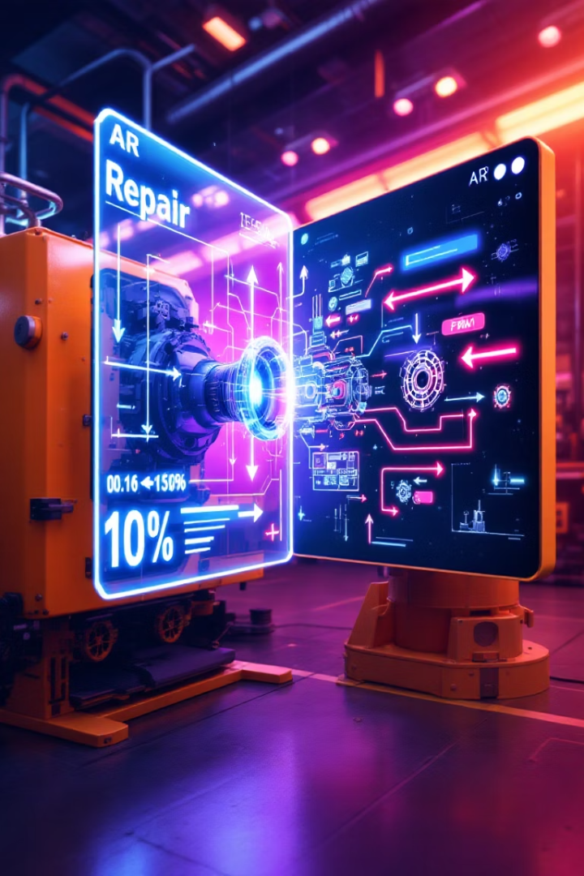




Our Solution: LLM-Powered AR Repair Guidance
Vision Recognition
Computer vision identifies equipment and diagnoses issues instantly
AI Processing
LLM pipeline generates step-by-step repair instructions
AR Display
WebRTC headset app overlays guidance on standard AR glasses
Results
Repair time reduced by 10x (4.7 hours → 28 minutes)

Slide 3
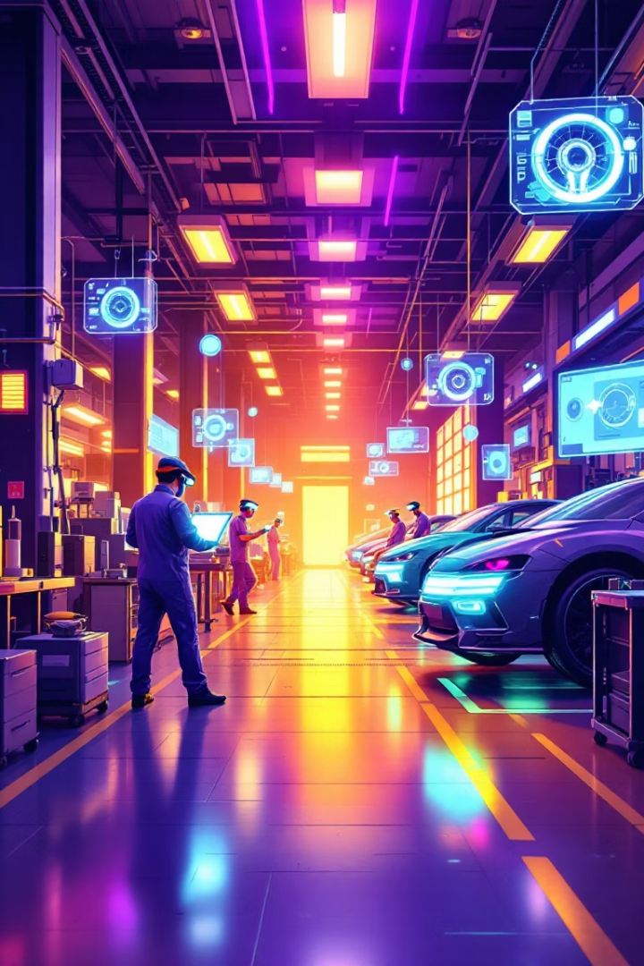
Case Study: Tier-2 Auto Parts Factory Implementation
87%
Downtime Reduction
Monthly downtime cut from 143 hours to just 18.5 hours
$2.4M
First-Year Savings
ROI achieved in just 4.2 months
94%
Adoption Rate
High technician adoption within six weeks
25K+
Procedures
Repair procedures cataloged and accessible

Slide 4






Business Model & Partnerships
Partner Network
12 major equipment OEMs providing technical data
Knowledge Base
85,000+ proprietary repair procedures
Business Model
$7,000 ARPA seat licensing with 92% retention rate

